Slide 1
Social Awareness Dashboard
THEME: Social Awareness AND PUBLIC DATA VISUALISATION
Prepared by: Team vanguard
institute: Technosavvys institute pvt ltd
Overview:
AI-driven dashboard promoting awareness on key social issues through real-time data and visual insights.
Tools & TECHNOLOGIES:
Python | Flask | HTML | CSS | JavaScript | Data Analysis | AI

Slide 2
Acknowledgment
Gratitude to TechnoSavvys Institute Pvt. Ltd. for organizing the hackathon and providing the opportunity to innovate.
Team: Vanguard
Team Leader: Bhoomika Sahu

Slide 3
Problem Statement
Lack of centralized awareness visualization about key social issues (environment, health, safety, sanitation, etc.)
Data is scattered, making it difficult for citizens and authorities to track real-time insights.
Absence of AI-driven tools for analyzing and classifying social data effectively.

Slide 4
Proposed Solution
An AI-driven dashboard providing data-driven insights for social awareness.
Integrates multiple data sources to present visual and analytical summaries.
Offers real-time tracking and actionable insights to support informed decision-making.

Slide 5
Key Objectives
Enhance public understanding of social issues through interactive visual data.
Enable authorities and NGOs to make informed, data-driven decisions.
Utilize AI classification and analytics to detect emerging awareness trends.
Deliver a centralized and user-friendly platform for transparent insights.

Slide 6
Technology Stack
Technologies Used:
Frontend: HTML, CSS, JavaScript
Backend: Python Flask
Data Analysis: Pandas, NumPy
AI Model: AI Component (Classifier using Keywords)
Visualization: Chart.js, Matplotlib, Seaborn

Slide 7
System Architecture
Workflow Overview:
Data Collection – Social awareness data gathered from surveys, reports, and online platforms.
Data Preprocessing – Cleaning and transforming data for consistency and accuracy.
AI Classifier – Uses keyword categories to classify issues (e.g., health, safety, sanitation, environment).
Data Visualization – Flask backend sends processed data to the web dashboard.
User Interaction – Admin and users explore charts, insights, and recommendations in real time.

Slide 8
Key Features
Interactive Dashboard: Real-time charts and summaries of social awareness data.
AI-based Classification: Automatically groups issues by category using keyword analysis.
Admin Panel: Secure access for managing and validating reports.
User-Friendly Interface: Clean, responsive, and accessible design for all users.
Data Insights: Visual trends that help authorities and citizens understand awareness levels.

Slide 9
Impact & Future Scope
Impact:
Promotes public awareness through transparent and data-driven insights.
Helps authorities and NGOs identify priority areas for action.
Encourages data-based decision-making and social responsibility.
Future Scope:
Integrate with live government and NGO APIs for real-time updates.
Expand to a mobile-friendly and cloud-hosted platform.
Add advanced AI models for predictive trend analysis and sentiment detection.

Slide 10
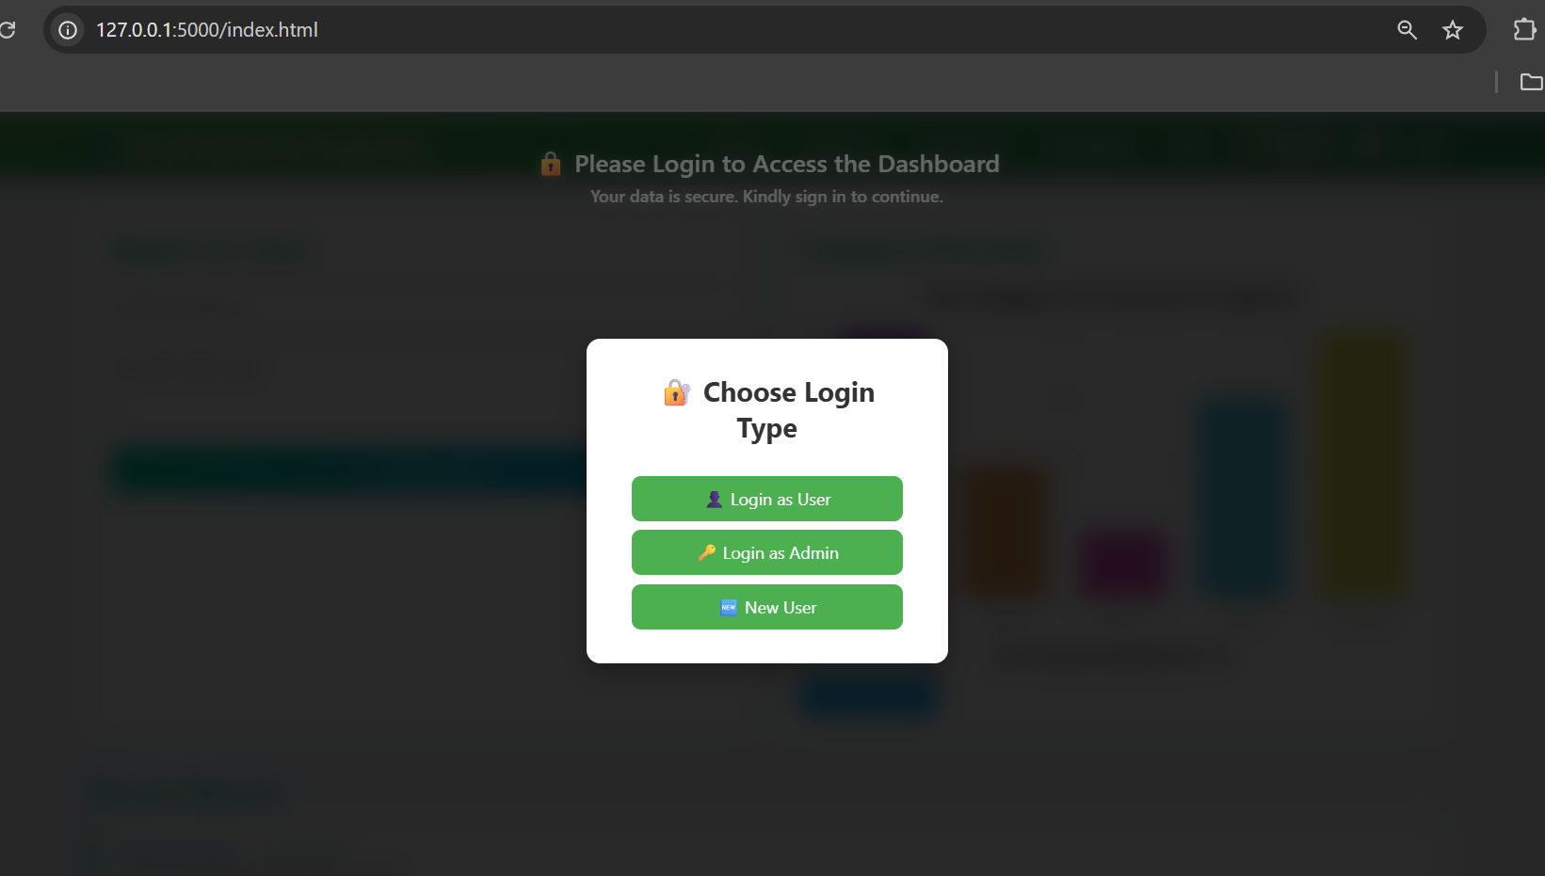
Login System Overview
Centralized login popup for both users and admins.
Supports three main flows:
User Login – Registered users access platform features.
Admin Login – Restricted access for administrative tasks.
New User Signup – Easy registration for first-time users.
Ensures security, role-based access, and usability.

Slide 11
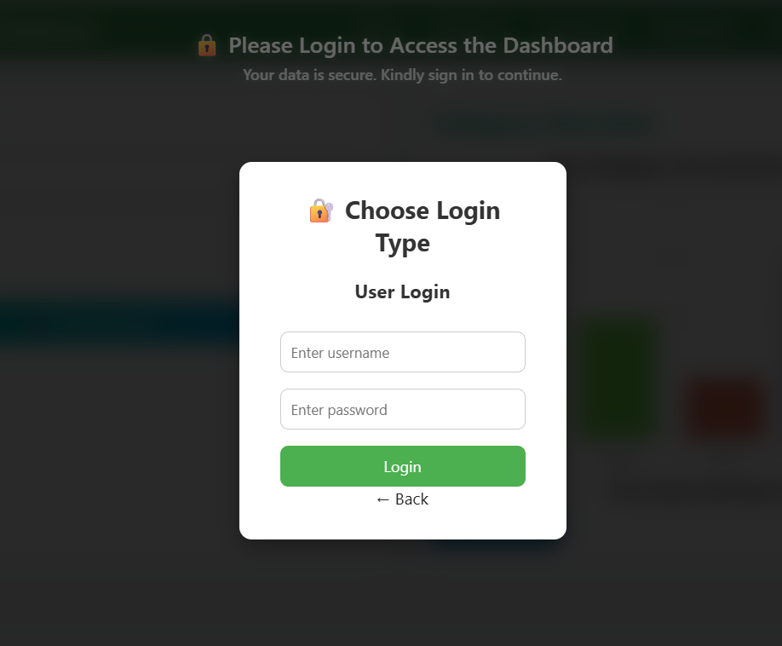
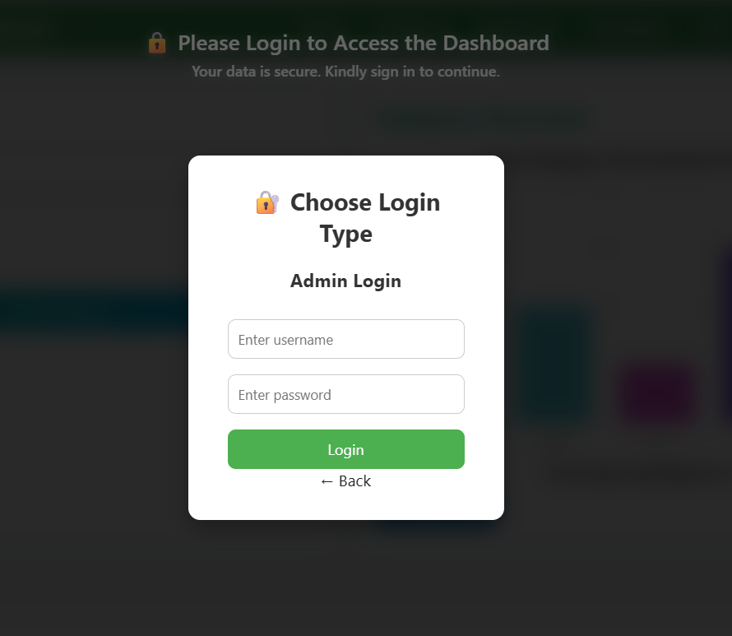
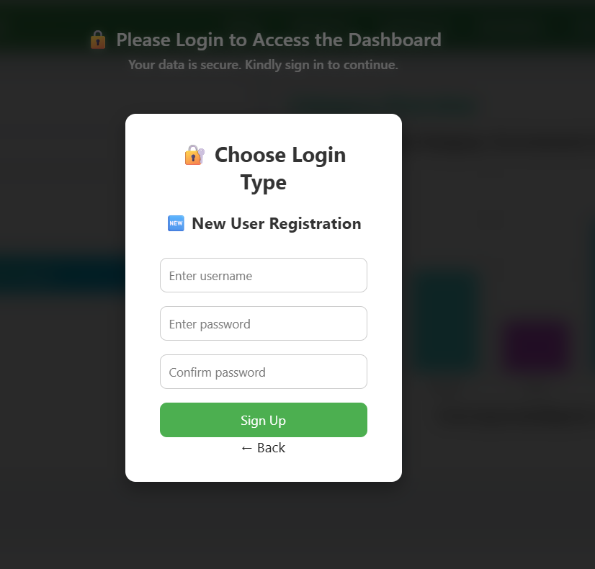
User Login, Admin Login, New User

Slide 12
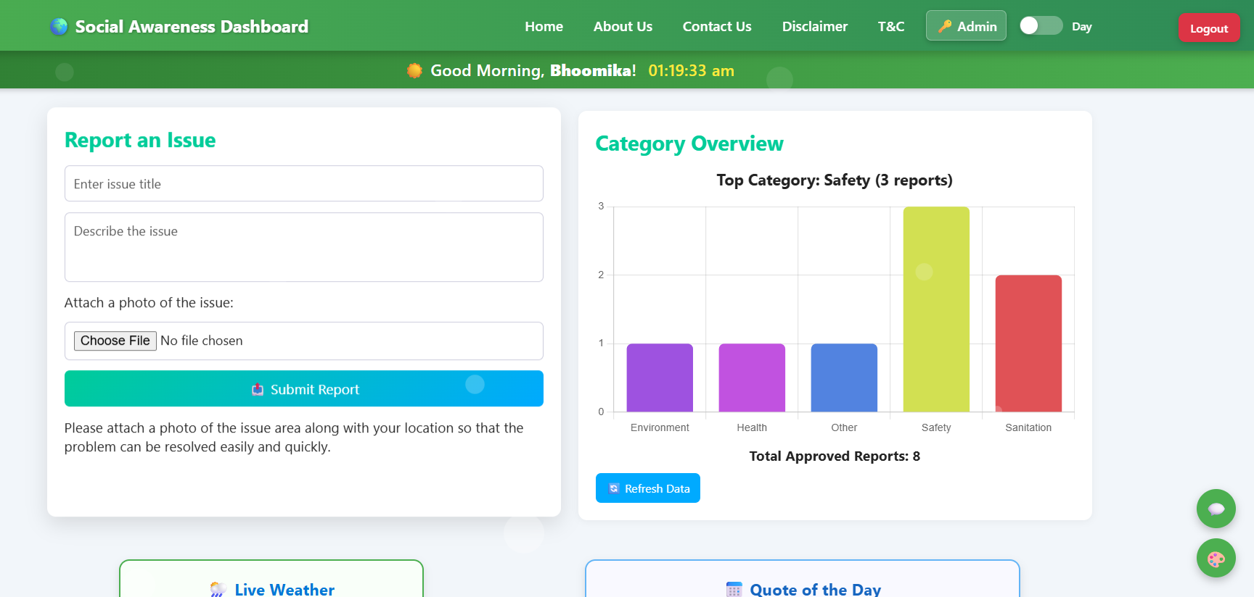
Dashboard Preview
Features Shown:
Interactive charts and graphs representing awareness topics.
Real-time data insights displayed through Flask dashboard.
Admin panel for managing and categorizing social reports.
AI-based keyword classifier for automatic issue tagging.

Slide 13
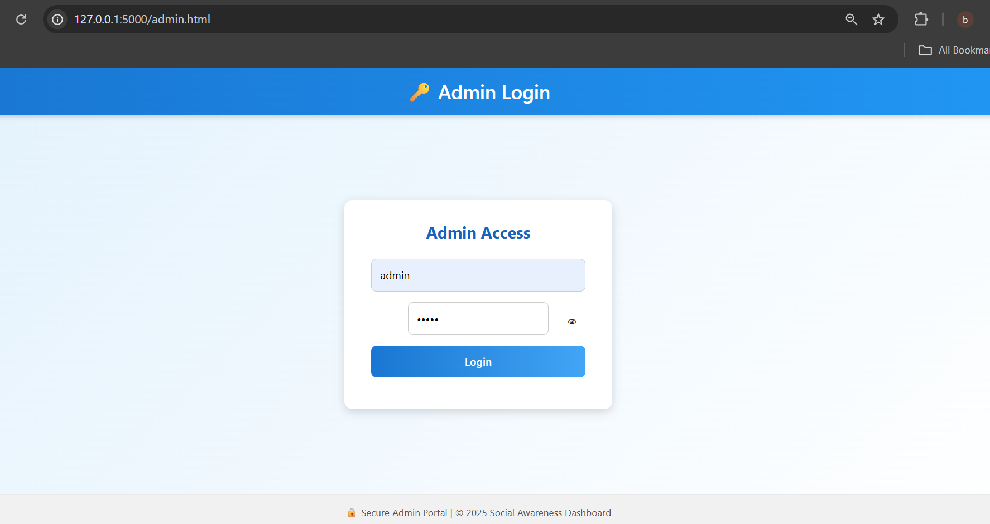
Admin Login
Provides secure access to administrative controls.
Built with HTML, CSS, and JavaScript.
Uses local authentication with predefined admin credentials.
Includes toast notifications for feedback (success/error).
“Show/Hide Password” feature for better usability.

Slide 14
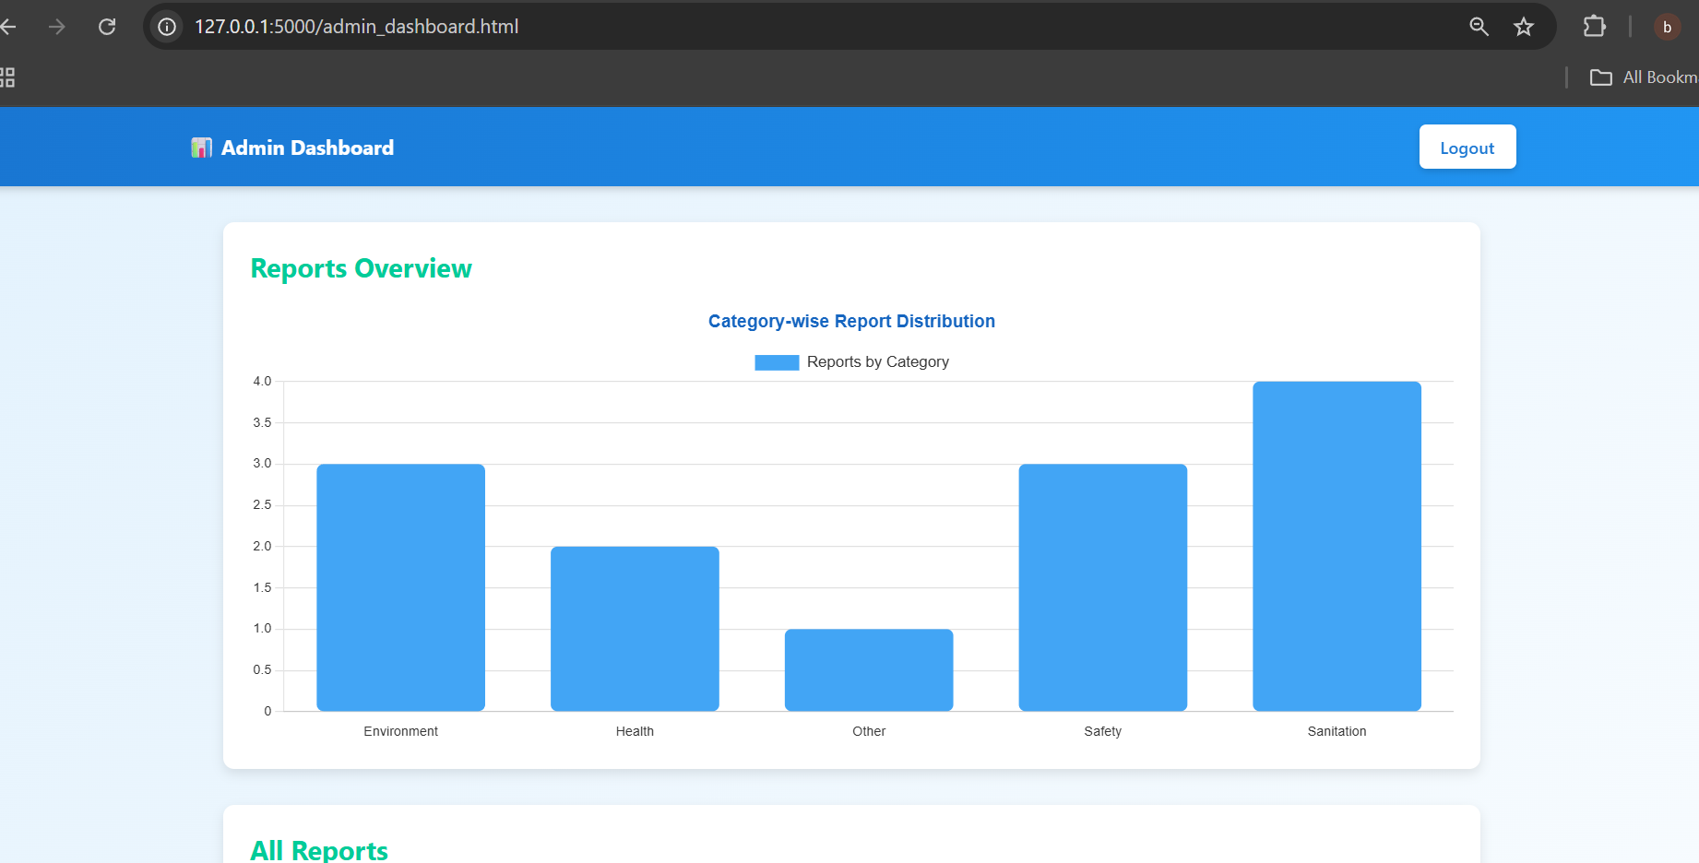
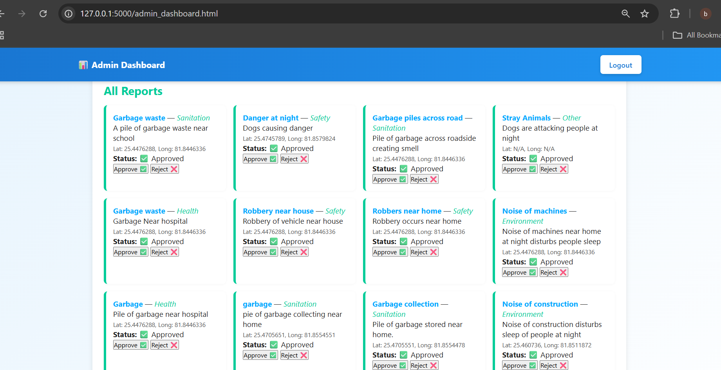
Admin dashboard
Displays all submitted reports with real-time status (Pending, Approved, Rejected).
Integrated interactive bar chart (Chart.js) for category-wise analytics.
Admin can approve/reject reports directly from dashboard.
Built using Flask backend + Chart.js frontend visualization.
Fully responsive and user-friendly interface.

Slide 15
Conclusion
Conclusion:
The Social Awareness Dashboard enhances visibility into real-world issues like environment, health, and safety.
Combines AI-powered categorization and data visualization for informed decision-making.
Provides a centralized, user-friendly platform to promote civic engagement and awareness.

Slide 16
Thank You
Team Member 1: Bhoomika Sahu ( Team Leader )
Team Member 2: Vipin Kumar Maurya
Team Member 3: Shashank Pal
Team Member 4: Himanshu Patel
Team Member 5: Altaf Ali
Project: Social Awareness Dashboard
📊 Tools: Python | Flask | Html | CSS | JavaScript | Data Analysis | AI
💡 “Data becomes powerful when it inspires awareness and action.”

